Slide 1
DE_Capstone Project - 1
Census Data Standardization and Analysis Pipeline

Slide 2
Problem Statement
The task is to clean, process, and analyze census data from a given source, including data renaming, missing data handling, state/UT name standardization, new state/UT formation handling, data storage, database connection, and querying. The goal is to ensure uniformity, accuracy, and accessibility of the census data for further analysis and visualization.
Tasks Assigned
Tools Used
Task 1: Rename the column names
Task 2: Rename state/UT names
Task 3: New State/UT formation
Task 4: Find and process Missing Data
Task 5: Save Data to MongoDB
Task 6: Database connection and data upload
Task 7: Run Query on the database and show output on streamlit
Python
Pandas
MySQL
XAMPP
MySQL Connector Python
MongoDB
PyMongo
Streamlit
VS Code

Slide 3
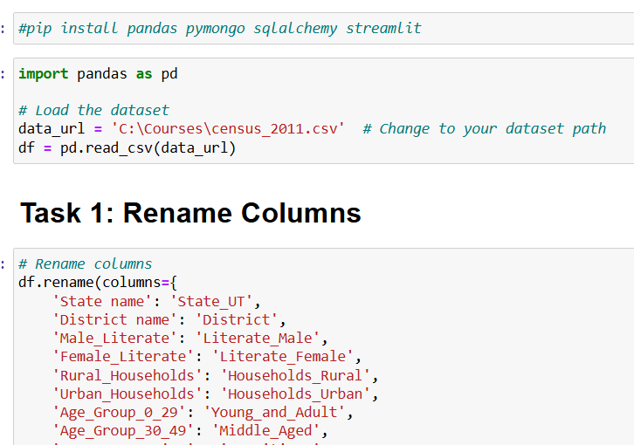
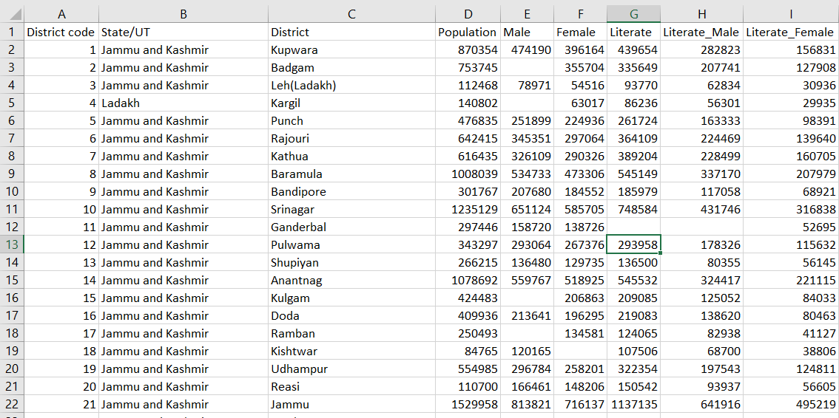
Approaches
Task 1: Rename the column names
The data is being read from a CSV file. The data is stored as a Pandas DataFrame. Once the Dataframe is created, we can easily manipulate using Pandas. For renaming the columns I have used a list with dictionary of old column names and new names as key-value pairs respectively, which can be passed into the rename function of pandas using a for loop.
Task 2: Rename State/UT Names
In order to standardize the entire data, the State/UT names have to be in the form of capitalized first letter and all other lower-case letters. If the word is ‘and’ then it should be in all lower case. In order to achieve this, I’ve used a for loop that gets State/UT name splits the name, capitalizes the word if it’s not ‘and’ and updates the Dataframe with the new value.

Slide 4
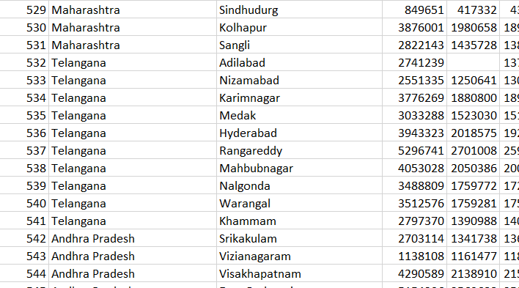
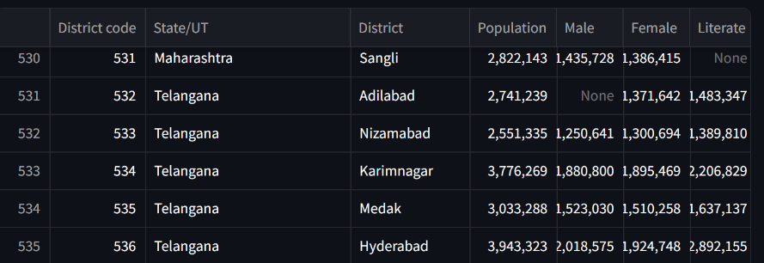
Approaches
Task 3 : New State/UT formation
After new rules were passed, some new State/UT were formed. All the districts that comes under new state are given in a text document. I’ve read the text document and run those values in a for loop and if the value matches, the State/UT name will be changed into the new one.
Task 4 : Find and Process Missing Data
In order to find the missing data, I have created a function which checks each cell in a specified column and returns True if it’s Null and False if it’s Not Null. In case the cell is null then another function checks for the required values. If all the required values are Not Null then necessary calculations will be done and the data will be stored in place of the Null. If all the values are Not Null then the calculations won’t happen and the cell remains Null.

Slide 5
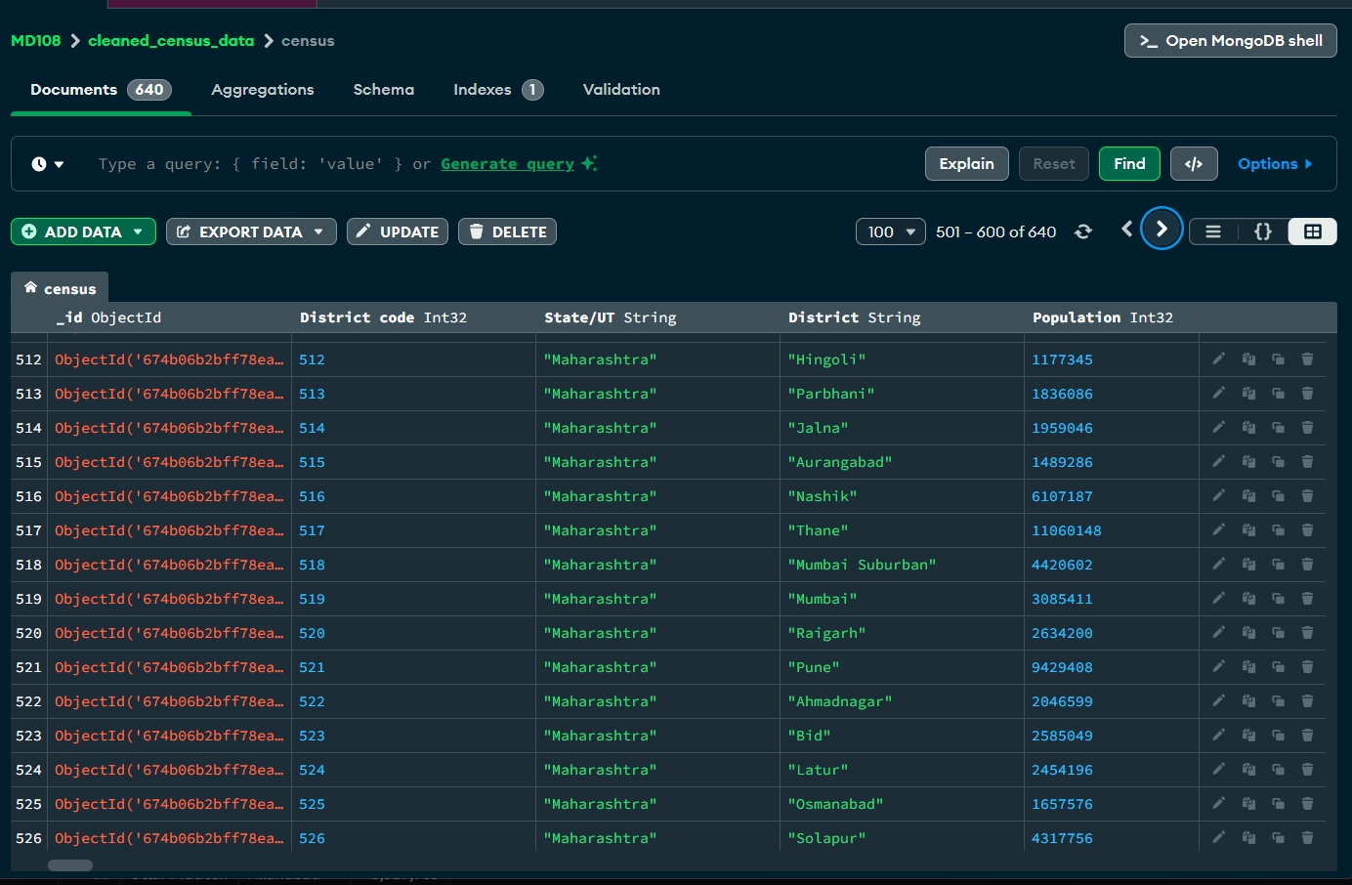
Approaches
Task 5 : Save Data to MongoDB
Once the data cleaning process is done, the cleaned data has to be stored in MongoDB. The MongoDB is accessed with the connection string which contains the DB name at the end as an extension. Which means if the Database with the specified name is not available, it will create one and if the database is available, it will just connect to it. Then the collection name is specified and checked. If a collection with specified name already exists it is deleted and a new collection is created with the same name, if not then a new collection is created.

Slide 6
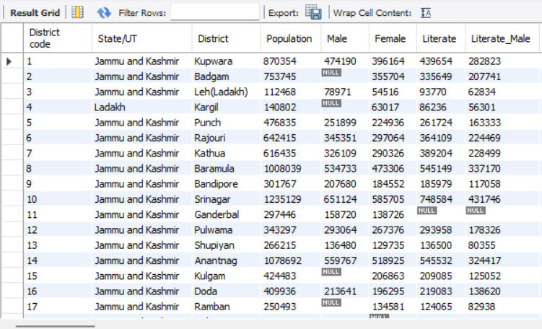
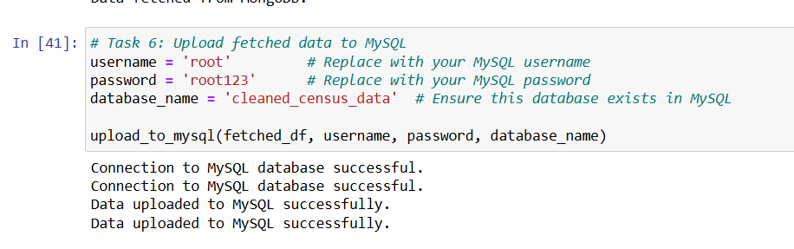
Approaches
Task 6 : Database connection and data upload
The data stored in MongoDB has to be retrieved and uploaded into MySQL Database. In order to achieve that, the connection between MySQL server and VS Code is made using MySQL connector Python. A Database is created if it does not exist already. For table creation, MySQL has some rules to Column name lengths and characters used in them. To comply with these, I have manually given column names where changes are required.
Then the column names are fetched from the table using query and data is retrieved from MongoDB based on the District Code as it’s the unique value (Primary key) and stored as list of values. And to insert Null values we are creating placeholders which has the string formatting (‘%s’) equivalent to the number of values we have. Then the Values are inserted using the execute many function.

Slide 7
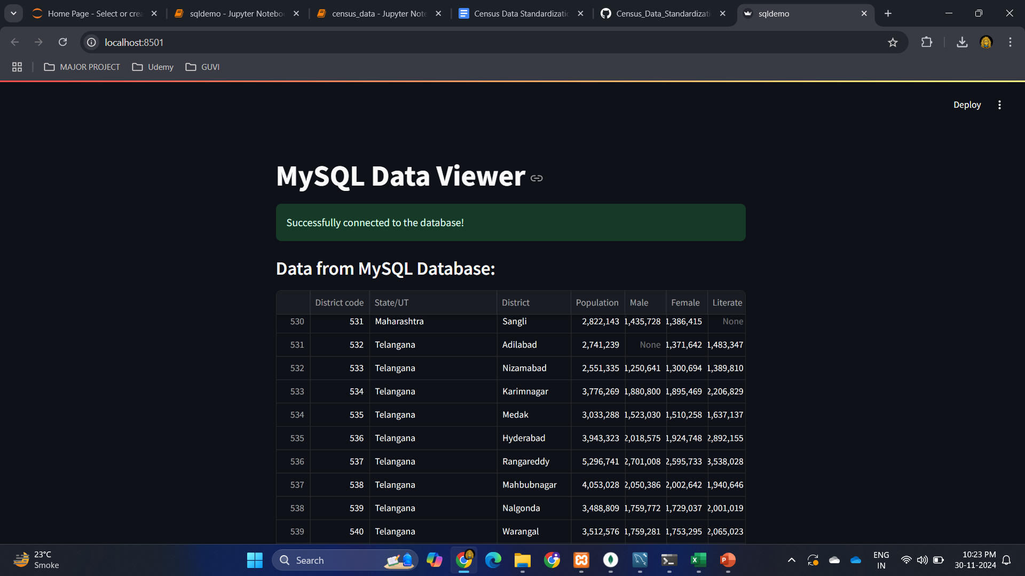
Approaches
Task 7 : Run Query on the database and show output in Streamlit
Streamlit does not have a multi-window functionality app. So, to display the results of all queries I’ve used a selectbox where the queries will be available as options. If the value of the selectbox changes, the result will be displayed based on the new value. In the backend the query result is extracted from the cursor and converted into Pandas DataFrame, which is then converted into Streamlit Dataframe to display in the app.

Slide 8
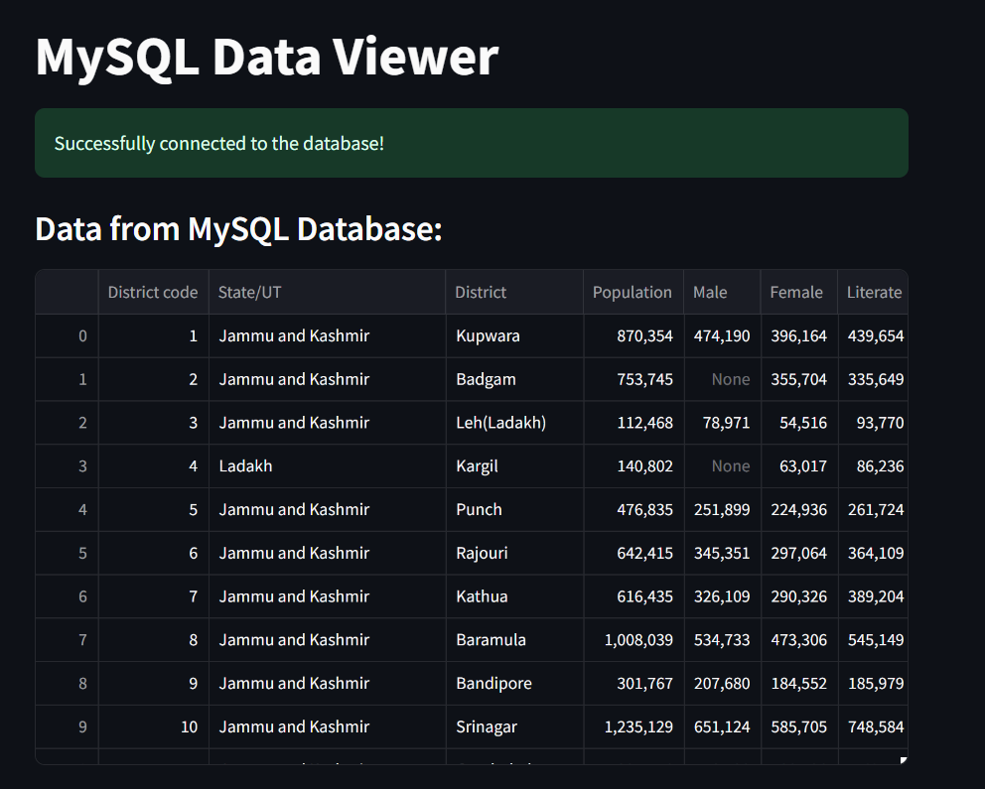
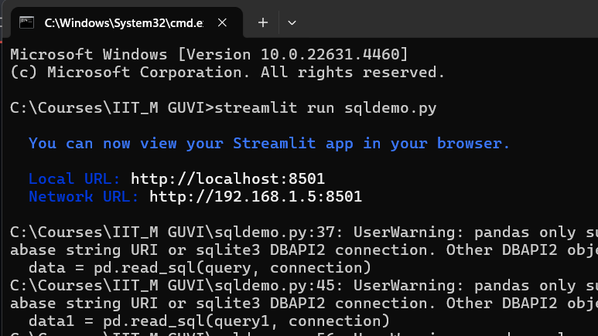
Insights
Run the Streamlit file sqldemo.py >> streamlit run sqldemo.py

Slide 9
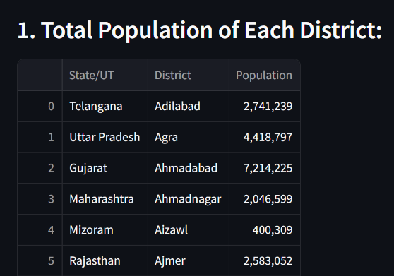
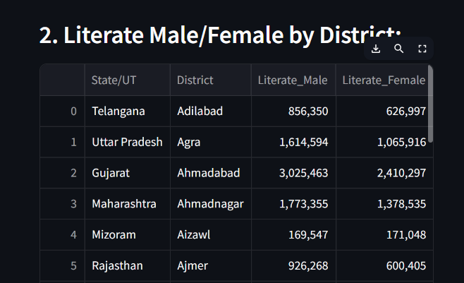
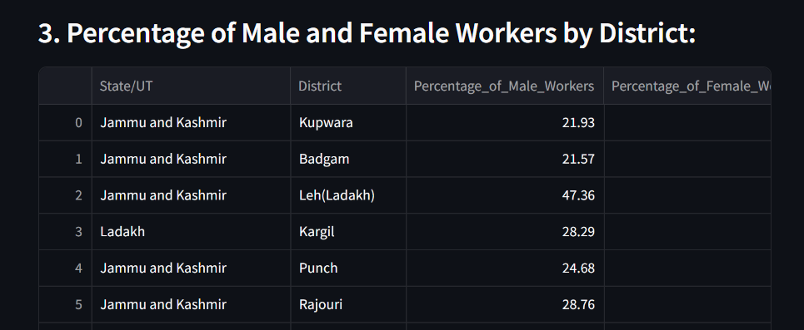
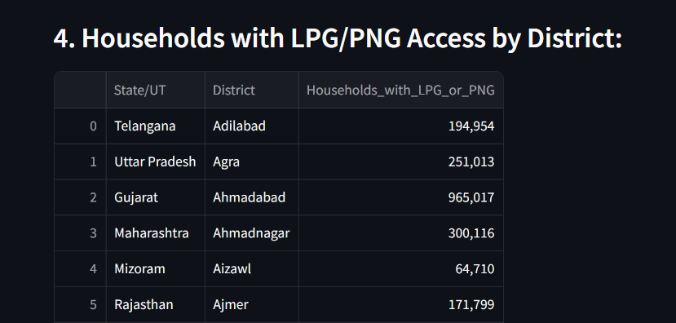

Slide 10
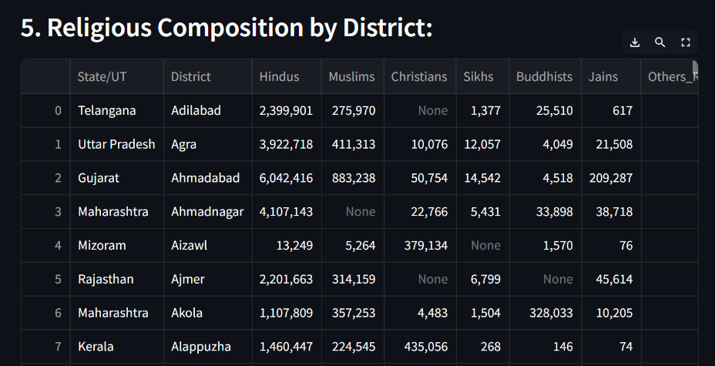
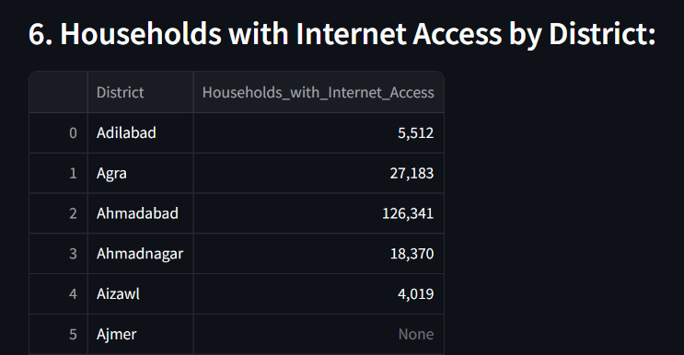
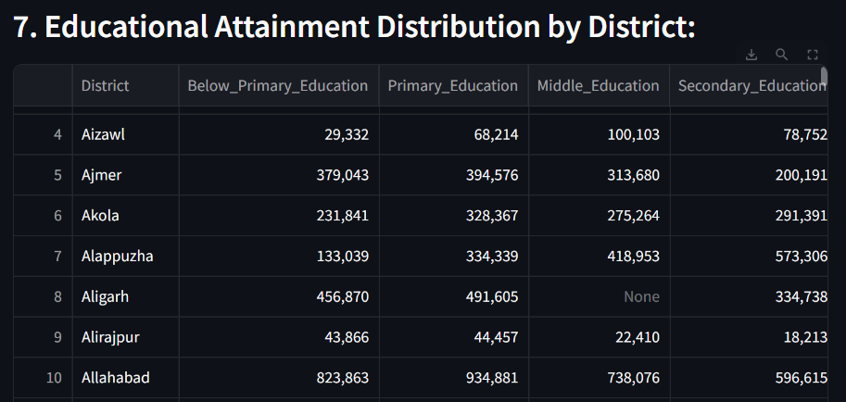
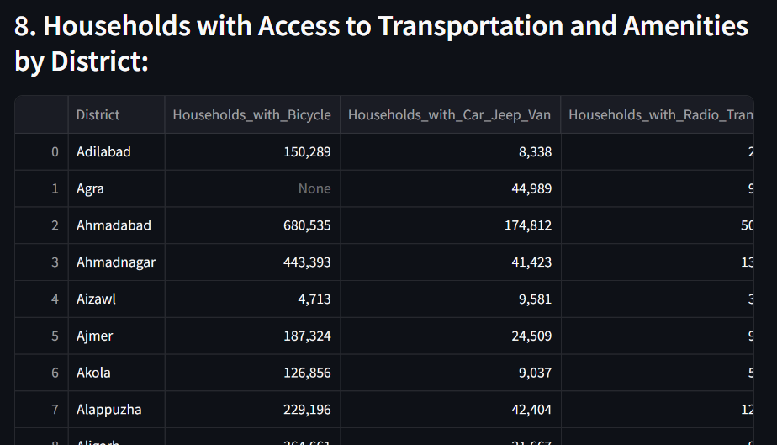

Slide 11
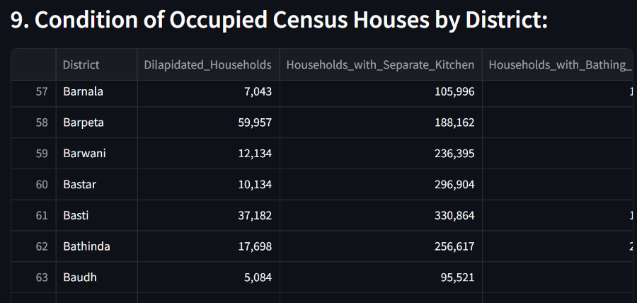
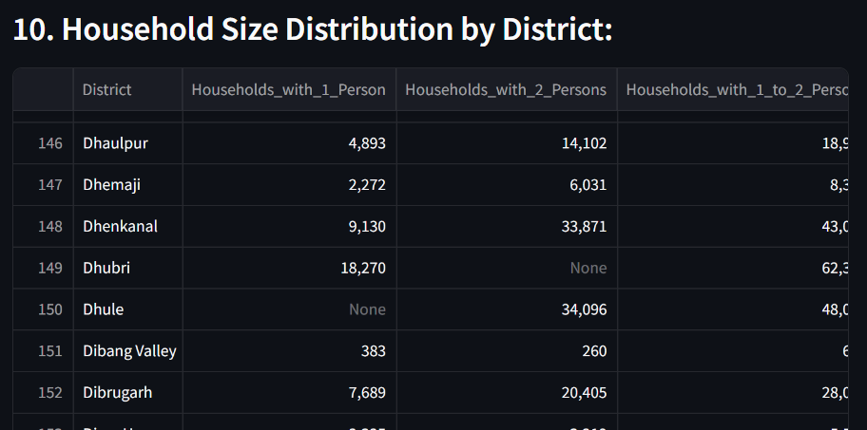
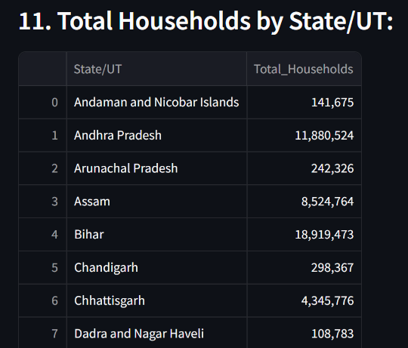
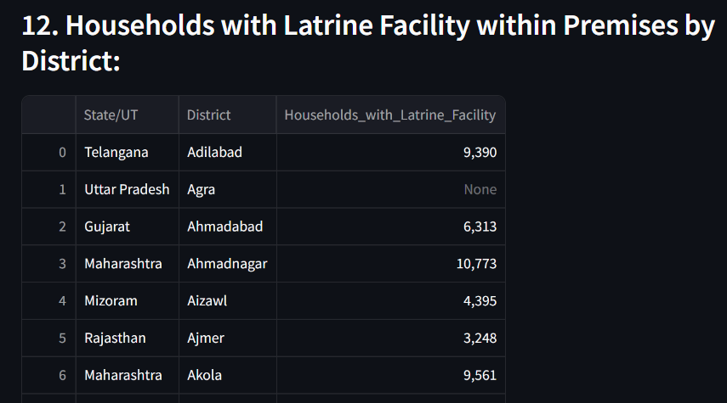

Slide 12
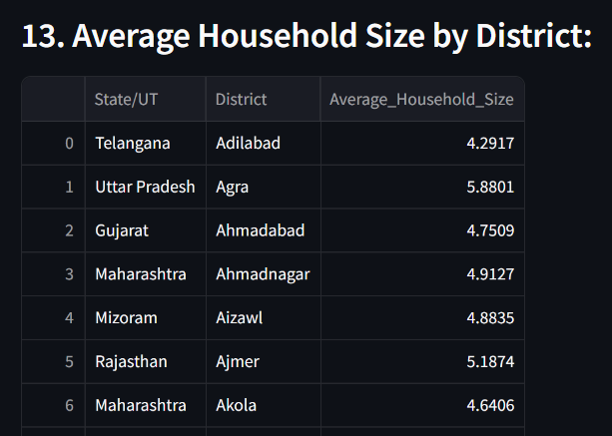
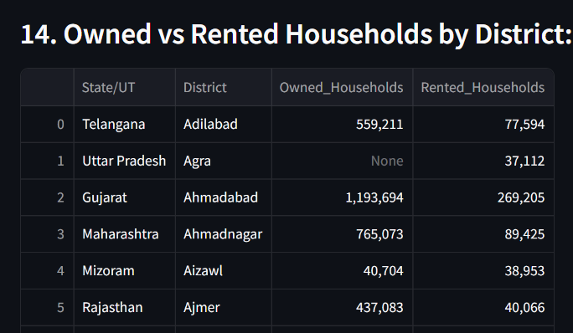
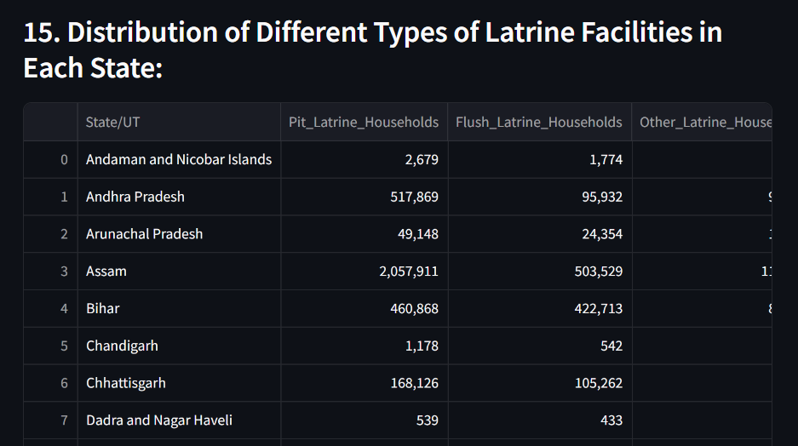
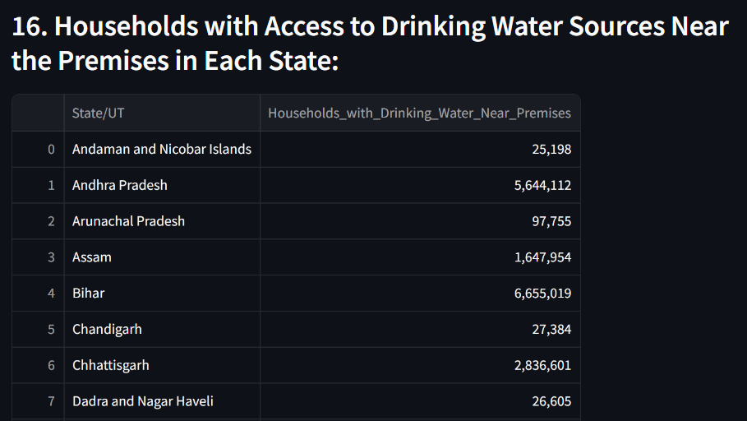

Slide 13
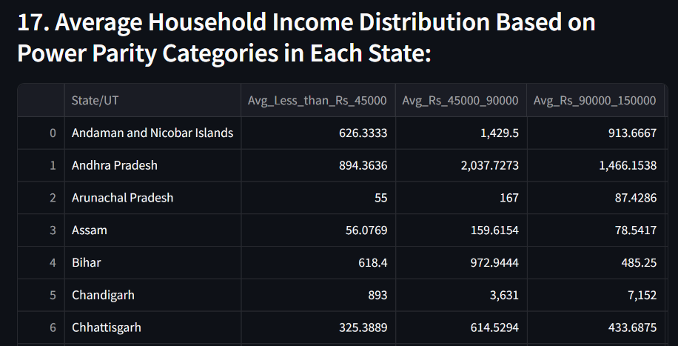
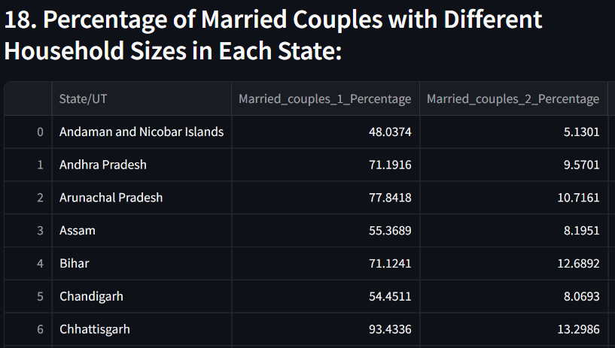
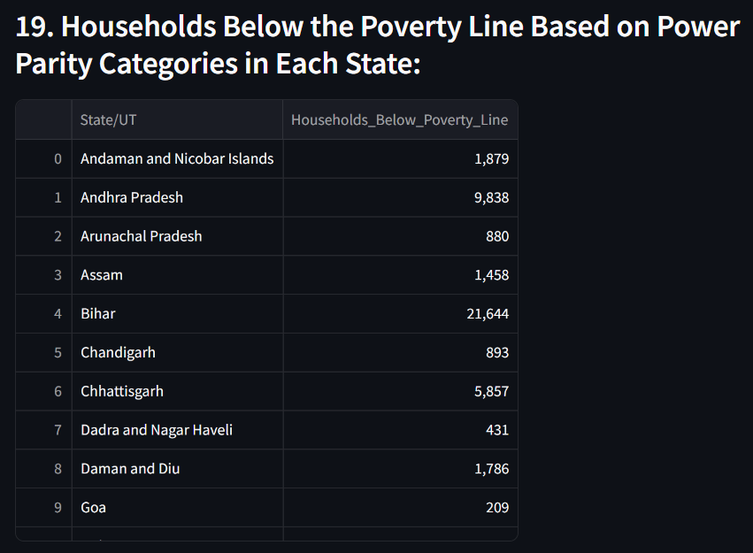
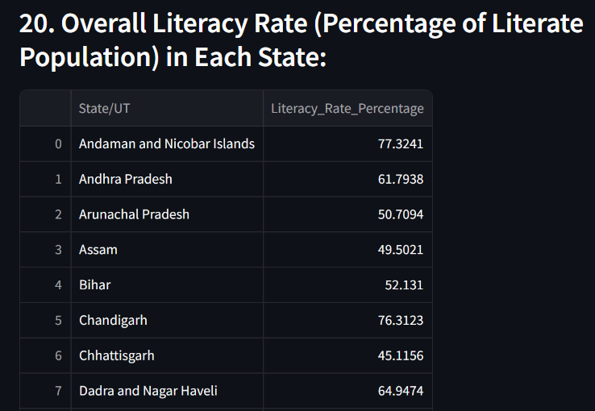

Slide 14
Thank you

